Slide 1


4.3 Constant current source circuit 电流源电路
The structure of the integrated operational circuit (IOC)
Intermediate stage
Input stage
Output stage
Biasing circuit
偏置电路
Biasing circuit: provide the proper static working points of all amplifier circuits
In IOC, constant current source are chosen as biasing circuits

Slide 2
4.3.1 Differential amplifier with constant-current source
带恒流源的差分放大电路
+V_{CC}
i_{C2}
i_{C1}
R_{C}
R_{C}
u_{C1}
+
-
u_{C2}
u_{O}
R_{B}
u_{O1}
R_{B}
T1
-
T2
+
+
u_{I1}
u_{I2}
-
i_{E1}
i_{E2}
-
R_{E}
-V_{EE}
Larger R_{E}, larger K_{CMR}, better performance!
However, when R_{E} is too large, V_{EE} is also very large
E.g. R_{E}=100 kΩ, I_{EE}=0.5 mA, V_{EE}=100.7 V

Slide 3
Use constant current source to replace R_{E}
+V_{CC}
i_{C1}
R_{C}
i_{C2}
R_{C}
u_{C1}
+
-
u_{C2}
u_{O}
R_{B}
u_{O1}
R_{B}
T1
-
T2
+
+
u_{I1}
u_{I2}
-
i_{E1}
i_{E2}
-
I
-V_{EE}
The property of constant current source:
1) Very high AC resistance
High K_{CMR}
2) Low DC resistance
Low V_{EE}

Slide 4


Constant current source made from transistor
Output curve of transistor
I_{C}
i_{C}
I_{BQ}
+
Q
c
i_{B}
b
u_{CE}
+
e
u_{BE}
i_{E}
-
-
0
U_{CE}
DC resistance: R_{CE}
AC resistance: r_{ce}

Slide 5
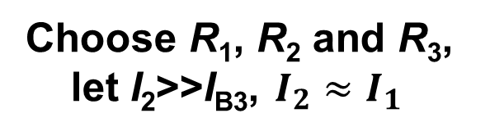
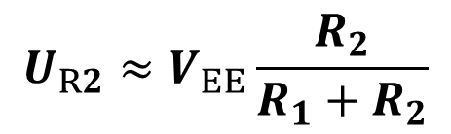
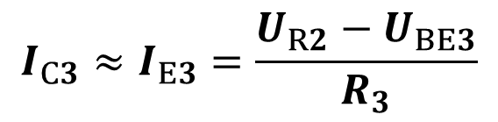
Use constant current source to replace R_{E}
+V_{CC}
i_{C1}
R_{C}
i_{C2}
R_{C}
u_{C1}
+
-
u_{C2}
u_{O}
R_{B}
u_{O1}
R_{B}
T1
-
T2
+
+
The voltage drop on R₂:
u_{I1}
u_{I2}
-
i_{E1}
i_{E2}
-
I_{C3}
I₁
I_{B3}
T3
R₁
I₂
R₂
R₃
I_{E3}
-V_{EE}

Slide 6







4.3.2 Current mirror 镜像电流源
T0 and T1 are identical
+V_{CC}
R
I_{R}
I_{C1}
I_{C0}
I_{B0}
I_{B1}
T0
T1
+
+
U_{BE0}
U_{BE1}
–
–
I_{C0} and I_{C1} are mirror symmetric

Slide 7
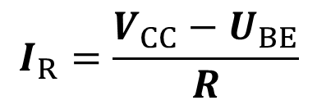

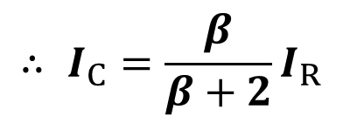
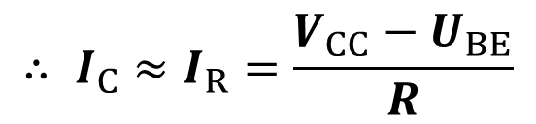
+V_{CC}
R
I_{R}
2I_{B}
I_{C1}
I_{C0}
I_{B0}
I_{B1}
Because β >>2,
T0
T1
+
+
U_{BE0}
U_{BE1}
–
–

Slide 8
The current mirror has temperature compensation effect 温度补偿作用
Temperature ↑
+V_{CC}
I_{C0} ↑
I_{C1} ↑
R
I_{R}
2I_{B}
I_{C1}
I_{R} ↑
I_{C1} ↓
I_{C0}
I_{B0}
I_{B1}
T0
T1
+
+
U_{R} ↑
U_{BE0}
U_{BE1}
–
–
U_{BE} ↓
I_{B} ↓

Slide 9
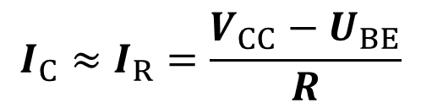
Merit: the current mirror is very simple and widely used
+V_{CC}
R
I_{R}
2I_{B}
I_{C1}
Drawback: For very high current I_{C}, the power consumption on resistor R is very high
I_{C0}
I_{B0}
I_{B1}
T0
T1
+
+
U_{BE0}
U_{BE1}
–
–

Slide 10





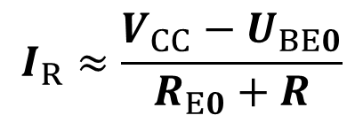
4.3.3 Scaling current mirror
比例电流源
T0 and T1 are identical
+V_{CC}
R
I_{R}
I_{C1}
I_{C0}
I_{B0}
I_{B1}
T0
T1
+
+
U_{BE0}
U_{BE1}
–
–
R_{E0}
I_{E0}
I_{E1}
R_{E1}

Slide 11




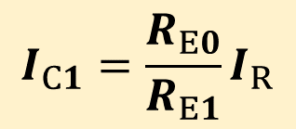
+V_{CC}
R
I_{R}
I_{C1}
I_{C0}
I_{B0}
I_{B1}
T0
T1
+
+
U_{BE0}
U_{BE1}
–
–
R_{E0}
I_{E0}
I_{E1}
R_{E1}
Through changing the resistance of R_{E0} and R_{E1}, we can increase or decrease I_{C1}

Slide 12

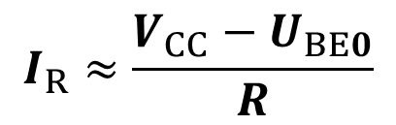



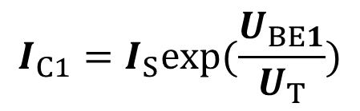
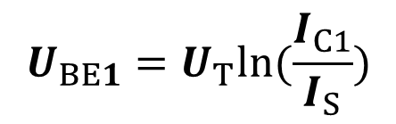
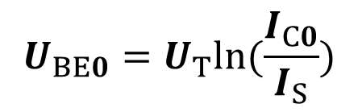
4.3.4 Small source current mirror 微电流源
Invented by Bob Wildar
+V_{CC}
R
I_{R}
I_{C1}
I_{C0}
I_{B0}
I_{B1}
T0
T1
+
+
U_{BE0}
U_{BE1}
–
–
I_{E0}
I_{E1}
R_{E}

Slide 13
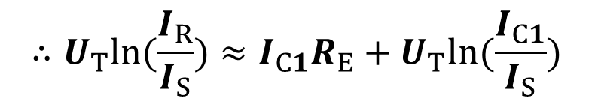
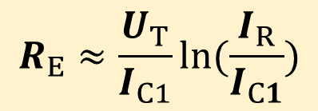

+V_{CC}
R
I_{R}
I_{C1}
I_{C0}
I_{B0}
I_{B1}
T0
T1
+
+
U_{BE0}
U_{BE1}
–
–
I_{E0}
I_{E1}
R_{E}

Slide 14
[1] I_{R}=0.73mA, I_{C2}=20μA, ask R_{E}=?
Ans:
+
+
–
–

Slide 15
[2] In question [1]，if we use current mirror instead of small source current mirror, ask the value of R to achieve I_{C2}=20μA, when V_{CC}=15V?
Ans: I_{C2}=20μA,
I_{R}=20μA
+
+
R≈V_{CC}/I_{R}=750kΩ
–
–

Slide 16
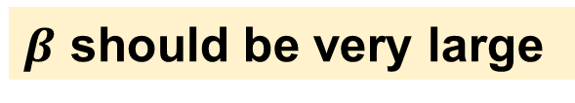
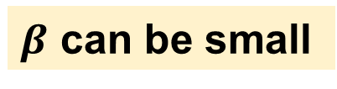
4.3.4 Improved current mirror 改进型电流源
+V_{CC}
+V_{CC}
R
I_{R}
R
I_{R}
I_{C1}
I_{C1}
T2
I_{C0}
I_{C0}
I_{B2}
I_{E2}
I_{B0}
I_{B1}
I_{B0}
I_{B1}
T0
T1
T0
T1
+
+
+
+
U_{BE0}
U_{BE1}
U_{BE0}
U_{BE1}
–
–
–
–
I_{E0}
I_{E1}
I_{E0}
I_{E1}
I_{R}= I_{C0} + I_{B0}+ I_{B1}
I_{R}= I_{C0} + (I_{B0}+ I_{B1})/(β+1)

Slide 17
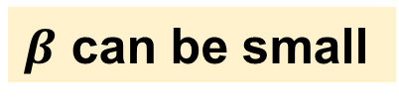





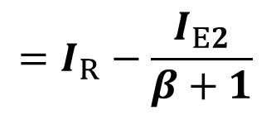
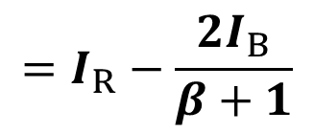
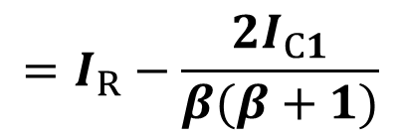
T0, T1 and T2 are identical
+V_{CC}
R
I_{R}
I_{C1}
T2
I_{C0}
I_{B2}
I_{E2}
I_{B0}
I_{B1}
T0
T1
+
+
U_{BE0}
U_{BE1}
–
–
I_{E0}
I_{E1}

Slide 18
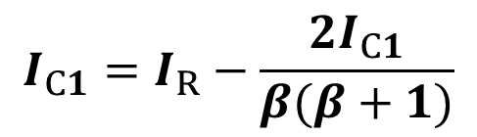
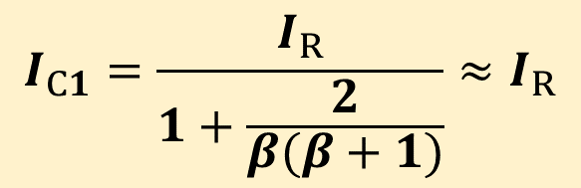
+V_{CC}
R
I_{R}
I_{C1}
T2
I_{C0}
I_{B2}
I_{E2}
I_{B0}
I_{B1}
T0
T1
+
+
U_{BE0}
U_{BE1}
–
–
Even β =10, I_{C1}=0.982I_{R}
I_{E0}
I_{E1}

Slide 19


Wilson current mirror
T0, T1 and T2 are identical
I_{R}
R
I_{C2}
I_{C0}
T0
T1
I_{C1}
I_{B0}
I_{B1}
I_{B2}
I_{E2}
1 point
I_{E0}
I_{E1}
T2
+V_{CC}

Slide 20




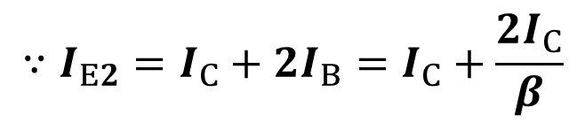
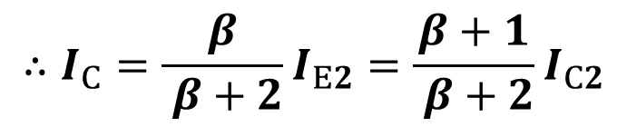
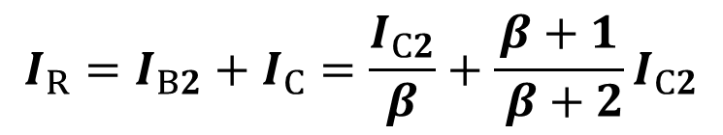
Wilson current mirror
T0, T1 and T2 are identical
I_{R}
R
I_{C2}
I_{C0}
T0
T1
I_{C1}
I_{B0}
I_{B1}
I_{B2}
I_{E2}
I_{E0}
I_{E1}
T2
+V_{CC}

Slide 21
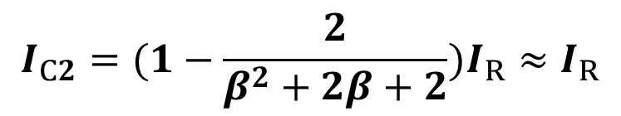
Wilson current mirror
I_{R}
R
I_{C2}
Even β =10, I_{C1}=0.984I_{R}
I_{C0}
T0
T1
I_{C1}
I_{B0}
I_{B1}
I_{B2}
I_{E2}
I_{E0}
I_{E1}
T2
+V_{CC}

Slide 22
Wilson current mirror
I_{R}
R
I_{C2}
Even β =10, I_{C1}=0.984I_{R}
I_{C0}
T0
T1
I_{C1}
I_{B0}
I_{B1}
I_{B2}
I_{E2}
I_{E0}
I_{E1}
T2
+V_{CC}

Slide 23
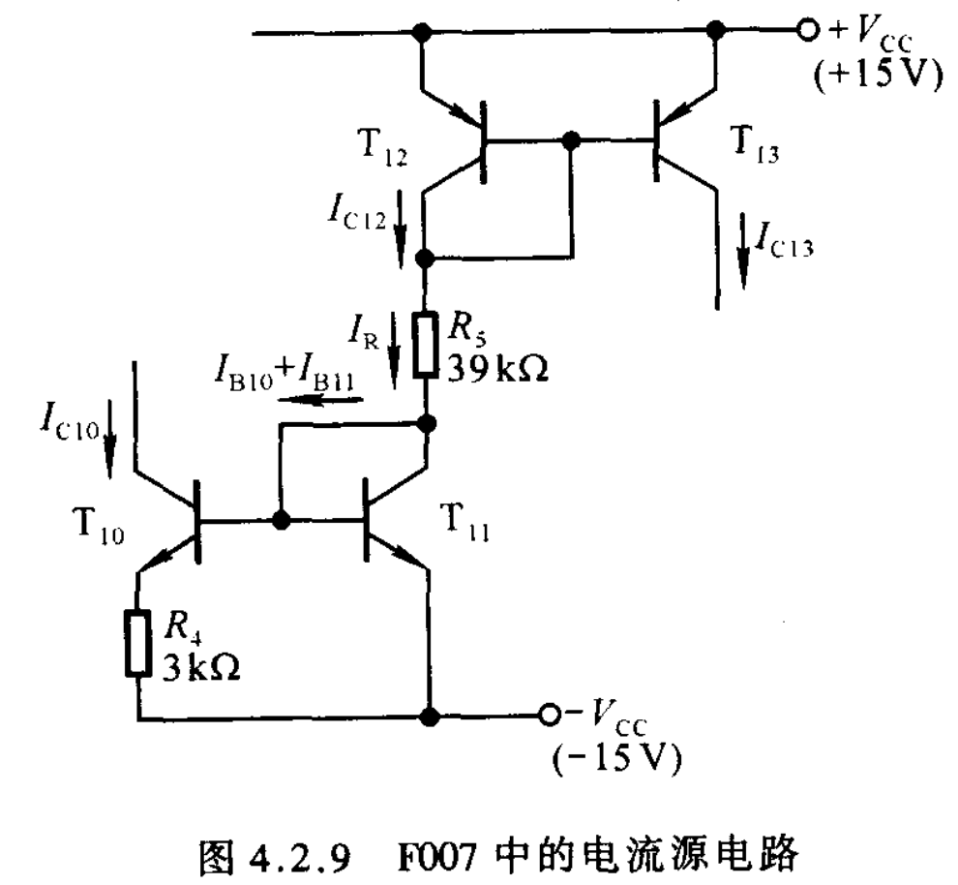
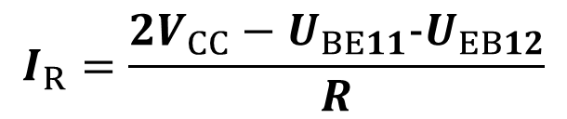

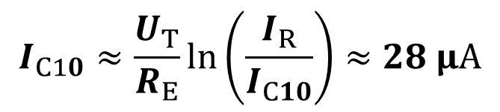
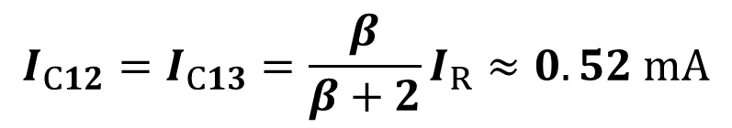
Q1: Figure shows the current source of IOC-F007. T10 and T11 are vertical PNP transistor. T12 and T13 are lateral PNP transistor. β=5, U_{BE}=0.7 V. Ask: the collector current of T10, T11, T12 and T13.
Mirror current source
Ans:
Small source current source

Slide 24
4.3.5 Amplification circuit with current source
1) Common-emitter amplifier with mirror current source
V_{CC}
R
R_{C}
I_{CQ1}
I_{R}
R_{B}
c
+
I_{C2}
T2
+
T3
T
+
b
u_{O}
T1
I_{B2}
I_{B3}
e
+
R_{B}
u_{O}
u_{I}
u_{I}
-
-
-
-
+V_{CC}
There is DC component in u_{I}

Slide 25
4.3.5 Amplification circuit with current source
1) Common-emitter amplifier with mirror current source
Replace R_{C} with current source
R
I_{CQ1}
I_{R}
I_{C2}
The current source （acting as a resistor） is also called active load 有源负载
T2
+
T3
T1
I_{B2}
I_{B3}
+
R_{B}
u_{O}
u_{I}
-
-
+V_{CC}
There is DC component in u_{I}

Slide 26



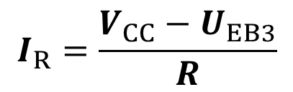
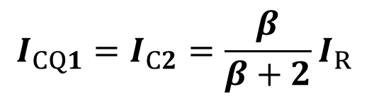
T2 and T3 are identical
R
e
I_{CQ1}
I_{R}
b
I_{C2}
c
T2
+
T3
T1
I_{B2}
I_{B3}
+
R_{B}
u_{O}
u_{I}
-
-
+V_{CC}
There is DC component in u_{I}

Slide 27

































e
b
R
+
+
+
-
-
+
R_{B}
-
-
+
+
R_{B}
-
-
R

Slide 28































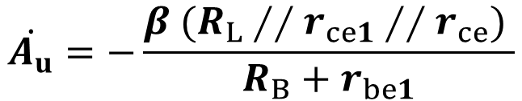
+
+
R_{B}
-
-
R
No load R_{L}
load R_{L}
+
+
+
R_{B}
+
R_{B}
R_{L}
-
-
-
-

Slide 29


















2) Differential amplifier with current source
Current mirror
Replace R_{C}
T5
T6
T1
T2
+
-
T4
T3
Scaling current mirror
Provide proper static working points for T1 and T2

Slide 30





















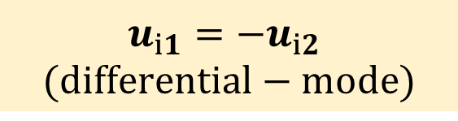




T5 and T6 are identical
Instantaneous value瞬时值
T5
T6
T1
T2
+
-
T4
T3

Slide 31









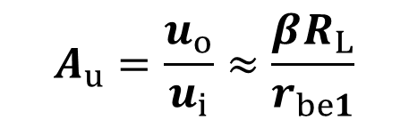










Voltage gain
T5
T6
T1
T2
+
Double the voltage gain of single-ended output using current mirror
-
T4
T3

Slide 32
























4.4 Integrated operational amplifier 集成运算放大器
Bipolar general integrated operational amplifier
双极型通用集成运算放大器
输入级
中间级
输出级
T₁
T₂
-
T₁₀
D₁
+
D₂
T₃
T₄
T₁₁
T₇
T₉
T₅
T₆
T₈

Slide 33
输入级
中间级
输出级
同相输入端
T₁
T₂
-
T₁₀
输出端
D₁
+
D₂
+
T₃
T₄
T₁₁
-
T₇
T₉
反相输入端
T₅
T₆
T₈

Slide 34
Non-inverting input terminal
Electronic symbol of integrated operational amplifier 集成运放符号
Output terminal
Inverting input terminal
同相输入端
+
反相输入端
-

Slide 35





u_{P}
+
u_{O}
u_{N}
-
Input signal u_{Id} = u_{P}-u_{N}
Linear amplification region
A_{od}: Open loop differential mode voltage gain 开环差模电压增益
In IOC, A_{od} can be >100,000

Slide 36





u_{P}
+
u_{O}
u_{N}
-
u_{Id} = u_{P}-u_{N}
Saturation region
If U_{OM}=14 V and A_{od}=500,000, integrated operational amplifier enters saturation region when |u_{P}-u_{N}|>28 μV

Slide 37
The equivalent model at low frequency
+
u_{Id}
u_{O}
-
(+)
+
A_{od}u_{Id}
r_{o}
-
+
u_{O}
u_{Id}
r_{id}
-
(-)

